Slide 1
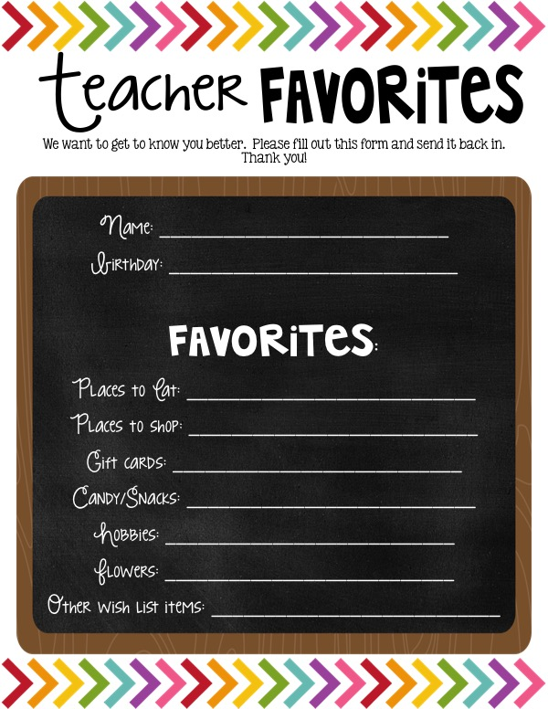
Anna Richardson
April 2
Anything! Mexican, sushi (edohana), steak, Italian/pizza, sandwiches
Target, Hobby lobby, Loft, Frances’s, Ulta, Banana Republic, Dillard's
X&F Foot Spa, Nail Salon: GrandLux or Glamour, AMC
Sour punch bites, Anything gummy, sour, PB m&m’s, popcorn, cookie cake
Crafting, anything aggie, crosses
Anything colorful, Sunflowers, hydrangeas
Sonic: cherry coke zero, Diet Vanilla DP; Starbucks: light caramel frap, iced white chocolate mocha, Iced Passion tango tea;
Coconut or Vanilla scents

